Slide 1
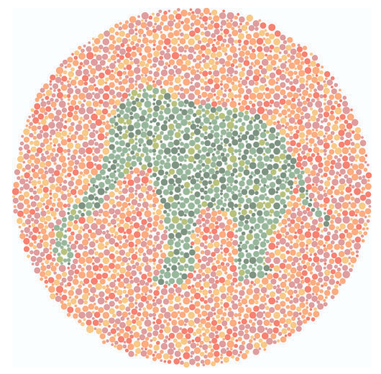
Do you see what I see? Introducing microshades: An R package for improving color accessibility and organization of complex data
Lisa Karstens, PhD
OHSU Department of Medical Informatics and Clinical Epidemiology
Fig. 1. Color Blind Test.
colorlitelens.com
Twitter: @lisakarstens
Notes:
Image: https://www.colorlitelens.com/kids-color-blind-test

Slide 2
Background
Normal Vision
Deuteranope
Color vision deficiency (CVD) impacts ~300 million people worldwide
Deuteranope : red-green color blindness
Protanope : mutated red pigment and less ability to discriminate colors
Tritanope : blue-yellow color blindness
Protanope
Tritanope
Color Blind Wheel colourblindawareness.org
Notes:
https://www.colourblindawareness.org/colour-blindness/#:~:text=Colour%20(color)%20blindness%20(colour,200%20women%20in%20the%20world.

Slide 3
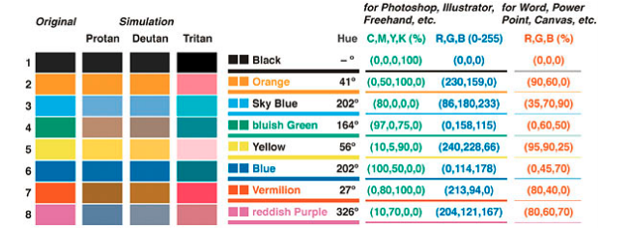
Current Palettes
Okabe Ito
Limitation:
8 colors is often not enough to visualize complex data
Okabe Ito Palette. Okabe, M., & Ito, K. (2008)
Notes:
Image source: https://www.reed.edu/economics/parker/311/Creating-Color-Blind-Accessible-Figures-ProfHacker---Blogs---The-Chronicle-of-Higher-Education.pdf

Slide 4
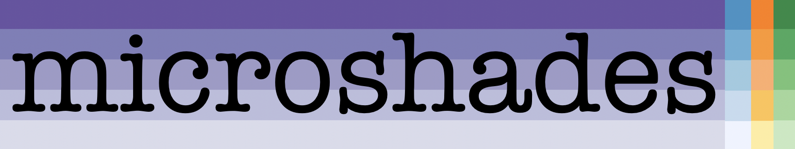
Our Solution
Develop custom color palettes incorporating shading
Expand to 30 colors
Universally CVD accessible
Provide functions for usage with microbiome data

Slide 5
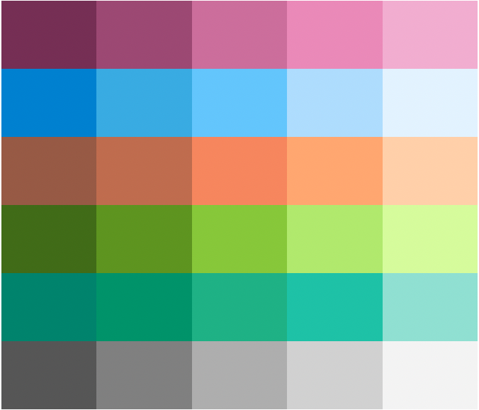
Microshades Palettes
microshades_cvd_palettes
micro_cvd_purple
micro_cvd_blue
micro_cvd_orange
micro_cvd_green
micro_cvd_turquoise
micro_cvd_gray

Slide 6
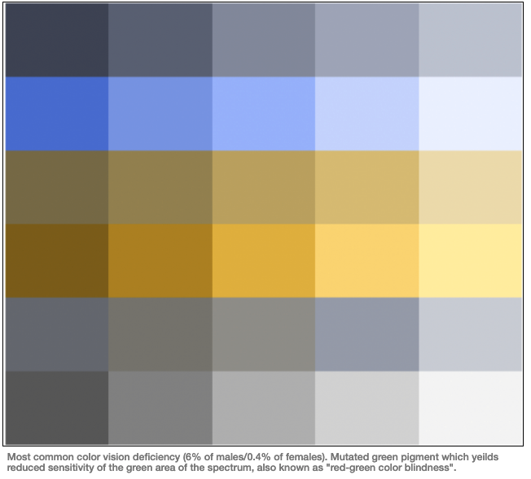
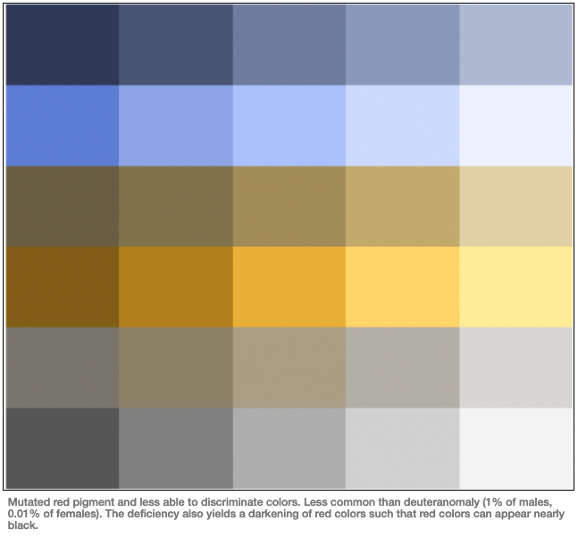
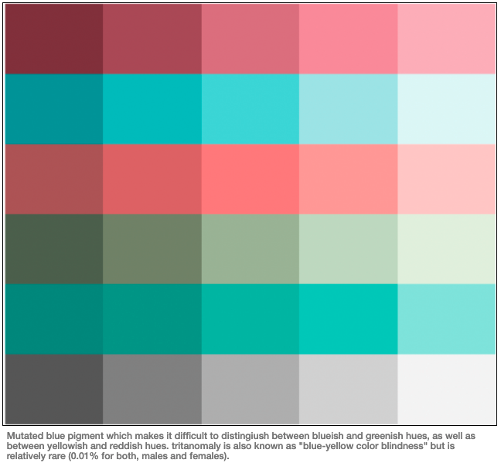
Colorblind simulations of microshades CVD palettes
Deuteranope
Protanope
Tritanope

Slide 7
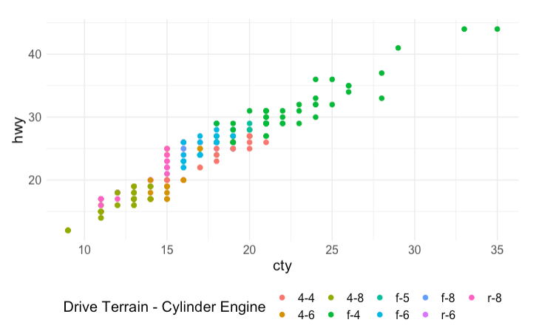
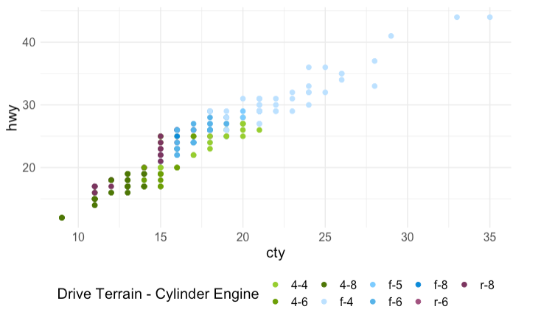
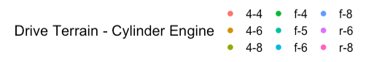
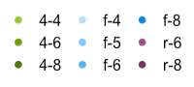
Microshades enhances data visualization of data
Default
microshades
Drive Train – Cylinder Engine
Drive Train – Cylinder Engine
**These plots use the mpg dataset

Slide 8
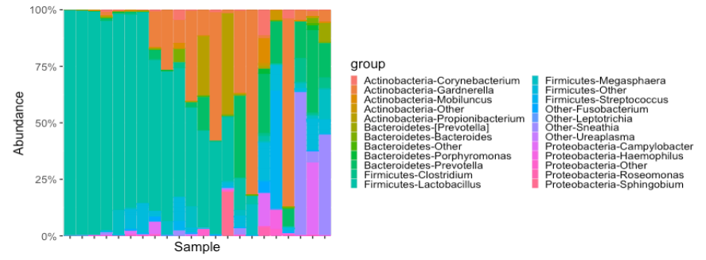
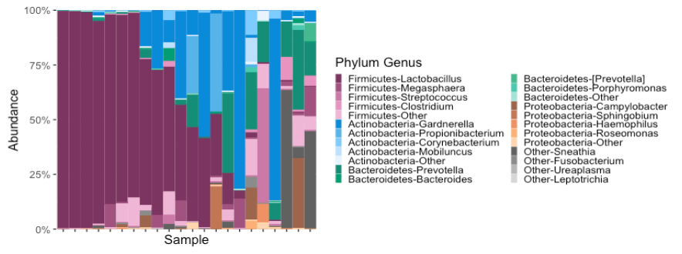
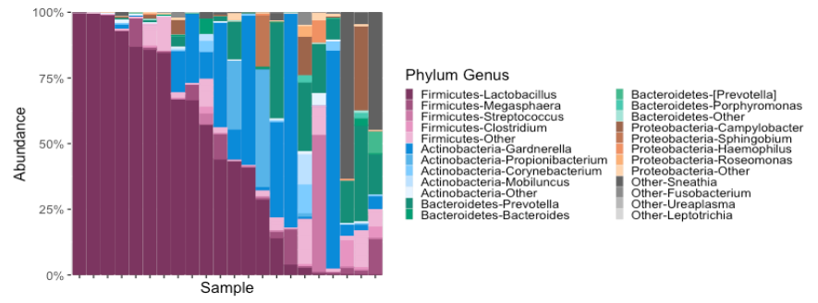
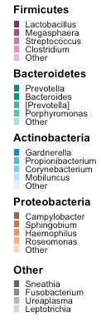
Microshades enhances data visualization of microbiome data
default
microshades color
microshades color + organization

Slide 9
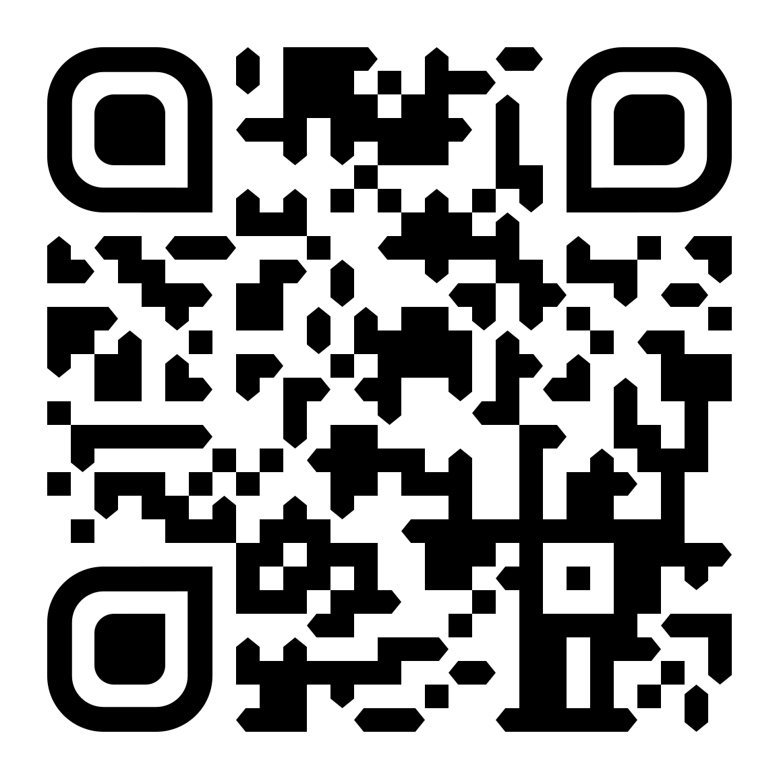
Thank you!
Special thanks to the Karstens Lab members at OHSU, especially Erin Dahl and Emory Neer!
Learn more about microshades:
bit.ly/microshades

